Slide 1
Employee Performance Analysis Using Excel
PRESENTED BY: Sakthi M
REGISTER NO : 312204620
DEPARTMENT : COMMERCE
COLLEGE : K.C.S KASI NADAR COLLEGE OF ARTS AND SCIENCE

Slide 2
PROJECT TITLE
Employee Performance Analysis Using Excel

Slide 3
AGENDA
1.Problem Statement
2. Project Overview
3.End Users
4.Our Solution and Proposition
5. Dataset Description
6. Modelling Approach
7. Results and Discussion
8.Conclusion

Slide 4
PROBLEM STATEMENT
Score Assignment to Employees: Verify that each employee’s rating is correctly assigned to either the "Fully Meets" or "Needs Improvement" category, or if not applicable (i.e., blank).
Calculate Category Totals: Ensure that the total scores for "Fully Meets" and "Needs Improvement" categories are accurately aggregated.
Validate Grand Total: Confirm that the grand total (sum of all ratings) aligns with the sum of individual category totals.
Employees are categorized into either "Fully Meets" or "Needs Improvement" performance levels based on their ratings.
There are no entries with missing (blank) ratings in this summary, which simplifies the data review.
The total scores for "Fully Meets" and "Needs Improvement" categories are 27,856 and 6,959 respectively, leading to a grand total of 34,815.

Slide 5
PROJECT OVERVIEW
[Employee Performance Improvement and Pay Zone Optimization]
Analysis Goals.
Deliverables
Verify Data Accuracy
Analyze Employee Performance Rating.

Slide 6
WHO ARE THE END USERS?
Human Resources (HR) Department
Department Managers (Sales & Production)
Senior Leadership/Executives
Employees
Finance/Compensation Teams

Slide 7
OUR SOLUTION AND ITS VALUE PROPOSITION
Filtering - Remove missing values.
Conditional Formatting - Blanks, Background Color Shading, Data Bars, Values.
Data Filtering and Sorting - Identify specific employee performance groups, such as those with exceeds, needs improvement and fully meets.
Pivot table - Summary of employee performance under their employee Id.
Graphs - Final Report with Trend line.

Slide 8
DATASET DESCRIPTION
EMPLOYEE ID: Unique identifier for each employee in the organization.
FIRST NAME: The first name of the employee.
PERFORMANCE SCORE: A score indicating the employee's performance level (e.g., Excellent, Satisfactory, Needs Improvement).

Slide 9
MODELLING
DATA SET: Kaggle, Employee dataset.
FEATURE SELECTION: Slicer, Conditional Formatting, Designing.
DATA CLEANING: Missing values, Irrelevant data, Correct Errors, Remove Unnecessary Columns and Rows.
PIVOT TABLE: Employee ID, First Name, Performance Score.
CHART: Report of Employee Performance based on their Employee Id is represent in Values and Performance Score presented as Column Chart.

Slide 10
RESULTS

Slide 11
CONCLUSION
The analysis will provide insights into the reasons behind performance disparities and offer recommendations for targeted interventions to improve overall performance.
The analysis will provide insights into the reasons behind performance disparities and offer recommendations for targeted interventions to improve overall performance.
The project will highlight any gaps in diversity and inclusion, offering recommendations for improving hiring practices and creating a more inclusive work environment.
Insights into supervisor effectiveness will inform management practices and help in designing training programs to enhance supervisory skills and support employee development.

Slide 12
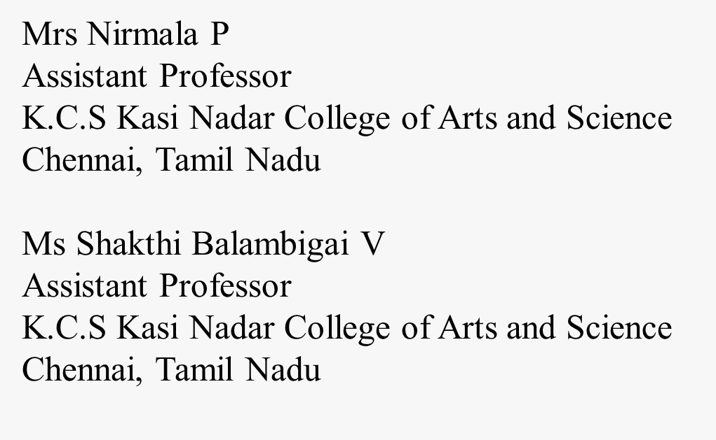
REFERENCE

